Slide 1
Gear Up for College
La Crosse Promise Future Center
Notes:
Hayley---folders at sign in table

Slide 2
Introduction
Future Center Staff
Notes:
Both

Slide 3
Goals
To provide an overview of the college going process between junior and senior year of high school
Understand how the Future Center can help achieve the post-secondary goals of the student/family
Notes:
Hayley

Slide 4
Organization/Professionalism Strategy
Come visit us!
College planning folder
Dates
User ID/Password information
Email/Voicemail
Social Media
More preparation early = less stress later
Notes:
Hayley

Slide 5
Junior Year
Standardized Tests
Campus Visit
Career and Major Exploration
Scholarships
Essays
Notes:
Matt-If you do the grunt work your junior year, it can make your senior year a breeze
KEEP THIS SIMPLE TO AVOID REPEATING

Slide 6
Standardized Tests
ACT (American College Test)
Four Subject Areas + optional writing portion
Will take at school in February for free
$46.00 or $62.50 with writing
Composite score and writing score
UW-Green Bay Middle 50% of admitted students
ACT Composite: 20-25
Notes:
Matt-most students take At least twice. Four areas-Math, Science, Reading, English
Look at the score of your interested schools
Prep materials and resources
Fee waivers available
accuplacer
Placement exams
If you take the ACT and score certain benchmarks you don’t need to take the accuplacer (info from Dave Fish If a student scores at least a 22 Reading, 22 Math and 19 English on the ACT – they don’t need to take the Accuplacer and are accepted to any program. If they have a 3.00 GPA or higher and have taken Algebra II and passed with a “B” grade or better both semesters, then they also do not have to take the Accuplacer and are total accepts.)
Some schools may require writing portion---look into this before you sign up and pay for this portion

Slide 7
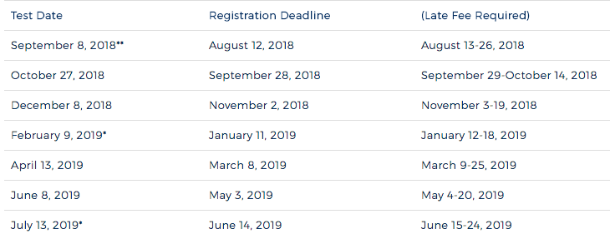

Slide 8
Standardized Tests
PSAT
Practice Test-Preliminary SAT
National Merit Scholarship
Accuplacer-usually offered at both high schools during year, otherwise Western
Notes:
Matt-PSAT generally taken in 11th grade and is the path for qualify for the National Merit Scholarships
Accuplacer

Slide 9
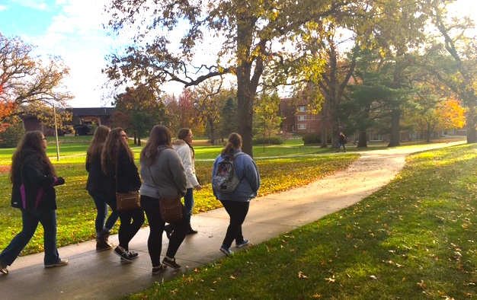
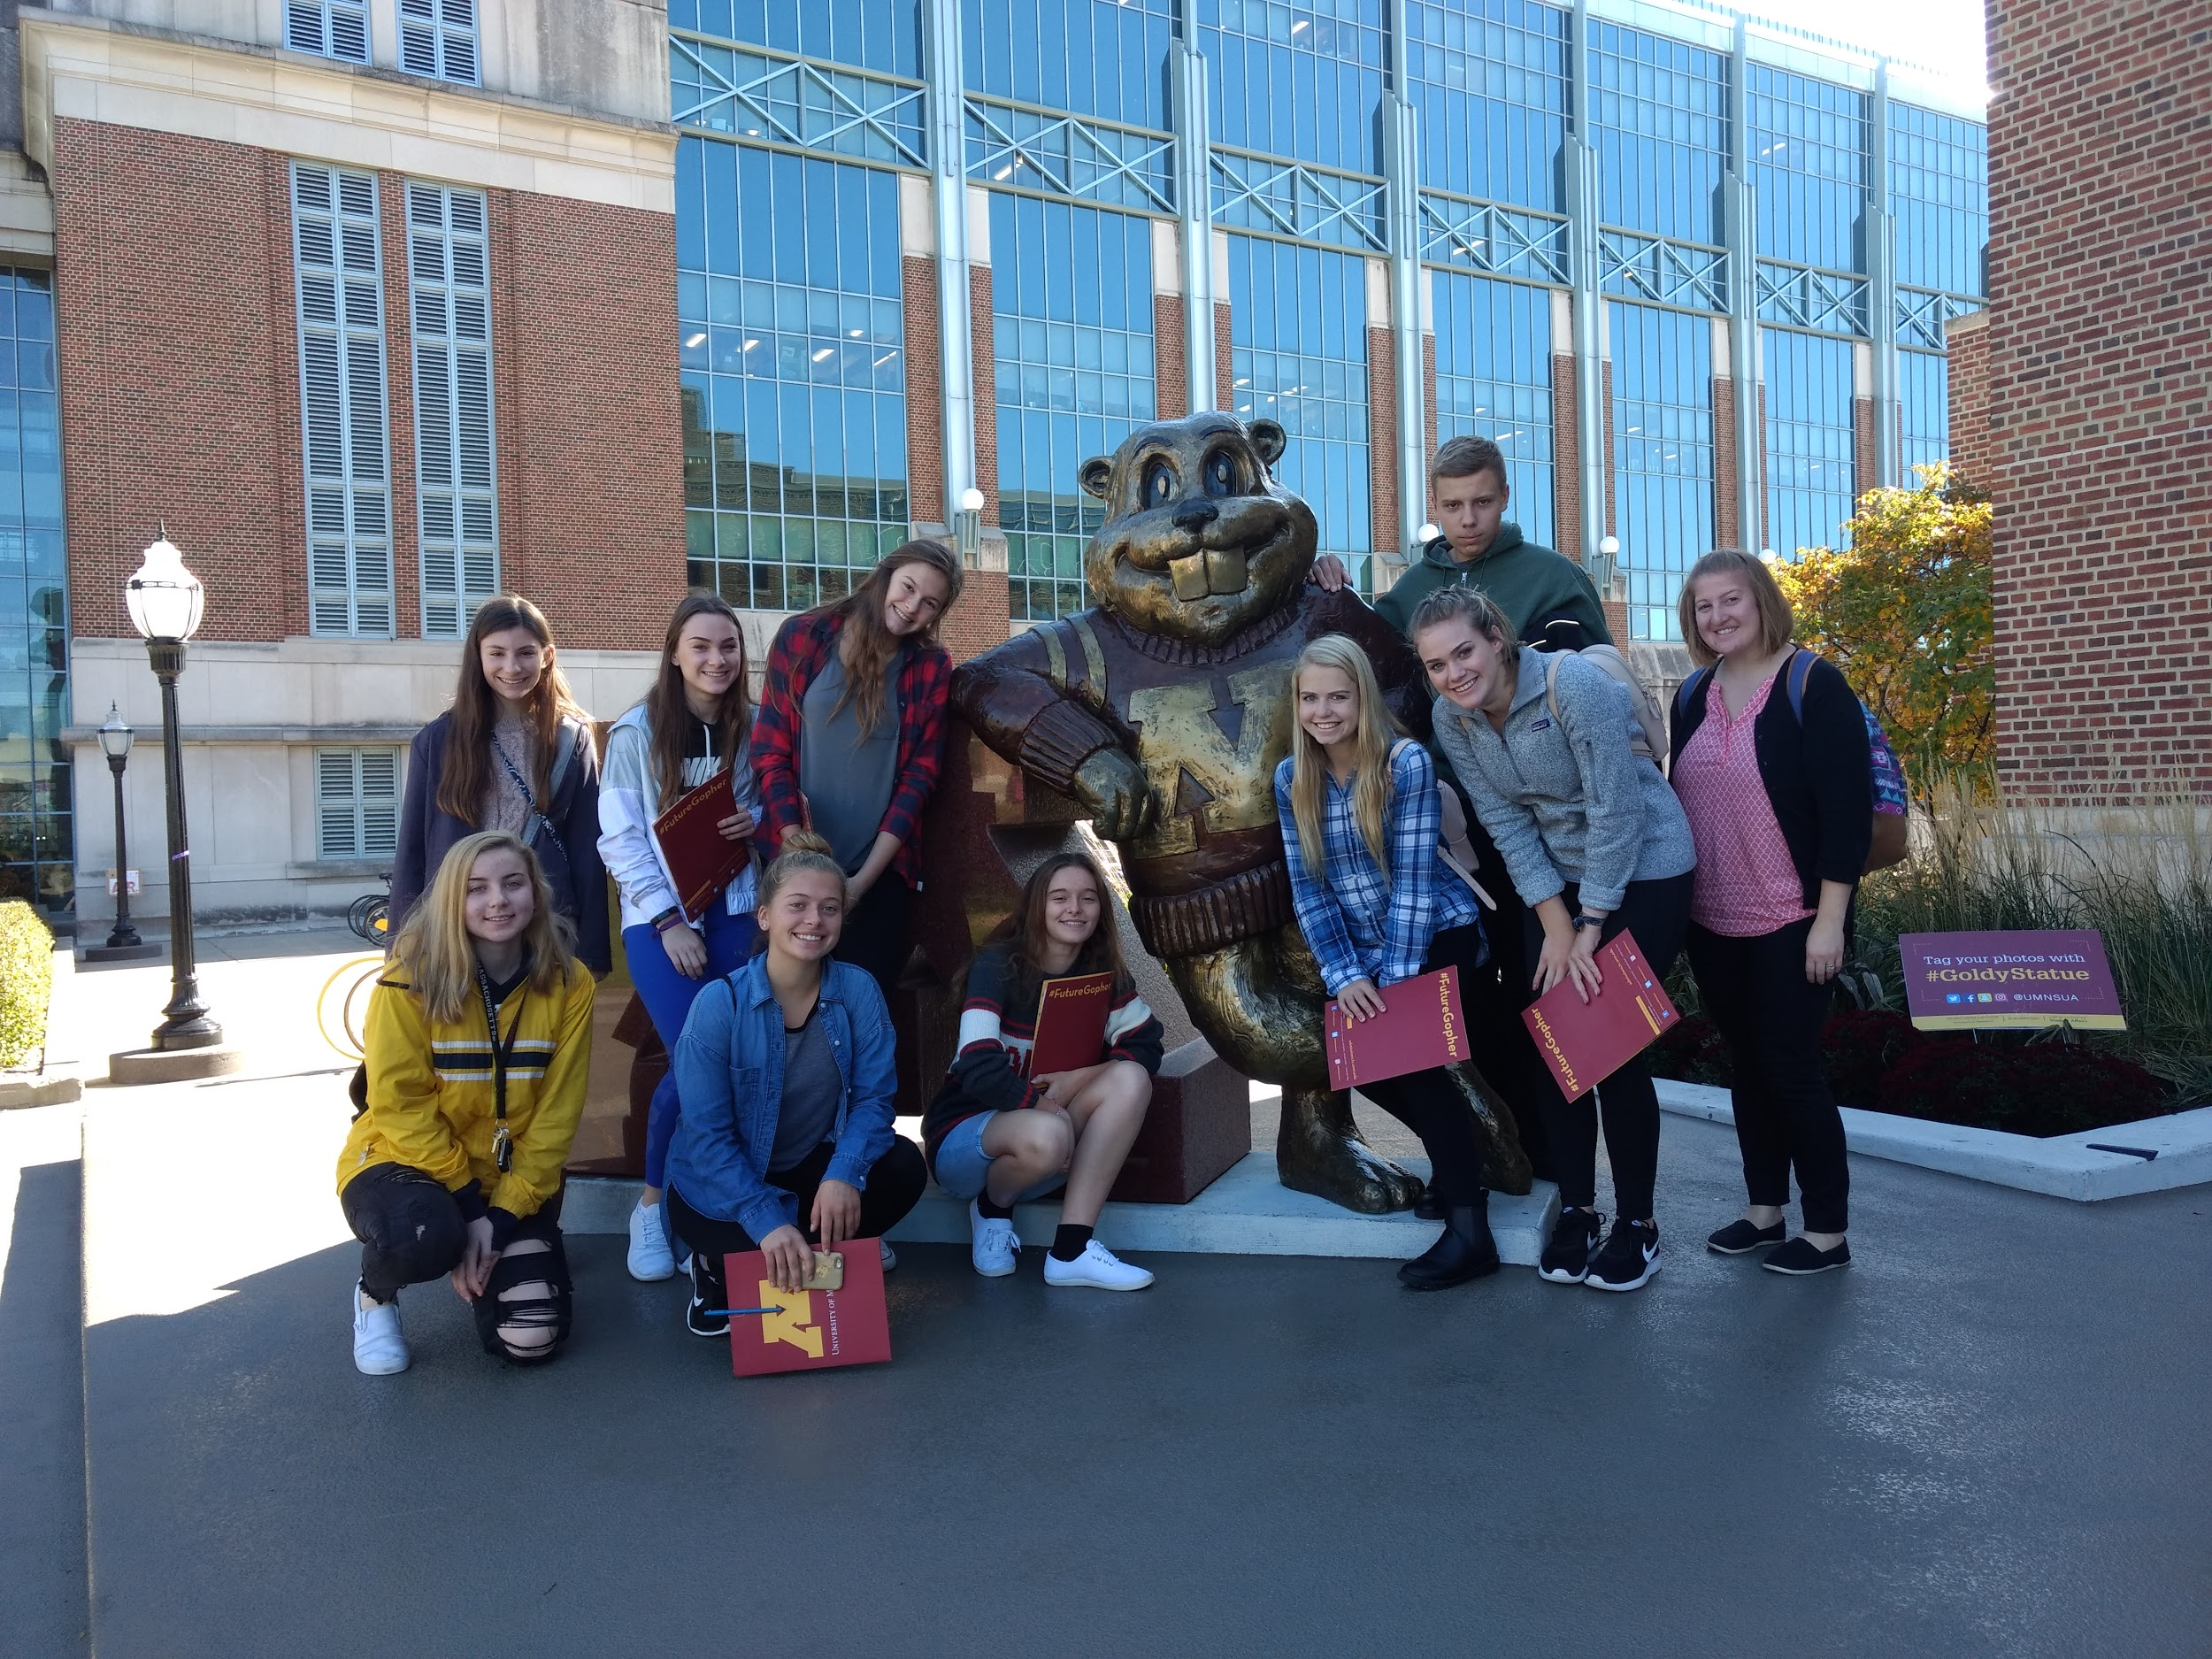
Campus Visits
October 15th: UW-Madison
October 29th: St. Olaf, Northfield, MN
November 9th: St. Mary’s/Winona State University
February 11th: Viterbo University
March 12th: UW-Stout
*$10/student,
contact advisor*
Notes:
Hayley
“Fit” when choosing a college. A combination of academic programs offered, extracurricular and small town and big town.
Coordinating your own visits
So many option, come talk to us! Public/private/location
Reference “Big Future” website offered through college board

Slide 10
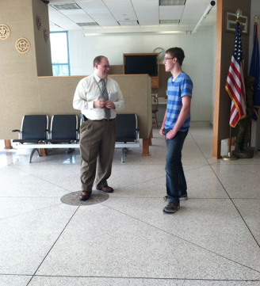
Career and Major Exploration
Assessment tests
Job Shadow
Veterinarian, Social Worker, Pharmacists
Program Shadows
Career Connections
Spring Job Fair
Partner events
Pizza & Professionals
WEF/Career Expo (Oct. 4th)
Notes:
Hayley

Slide 11
Essays
Essay writing workshop Wednesday, October 3rd Logan High School, rm 125, 6pm
What are admissions offices looking for?
Prompts - apply.wisconsin.edu
Come in for help!
Notes:
Hayley

Slide 12
Senior Year
Applying for schools
What do schools look at?
FAFSA
Scholarships
Notes:
Hayley
KEEP SIMPLE TO AVOID REPEATING LATER

Slide 13
Applying to College
Early Decision vs. Early Action
ED-binding, EA-find out earlier
School applications
Common app
Westerntc.edu
Apply.wisconsin.edu
Applicant statements
Notes:
Matt-Social Security Number, birthdates and other basic information
UW system application opens Aug 1. Hit submit September 1st.
Early decision are binding. Early Action are not, apply by a certain date to be decided by a certain date. Example Madison Fall Early Action Deadline: Nov. 1
Notification: By the end of January
**schools expect you to withdraw your application from other schools**
Explain the “why I should apply early” concept--2000 spots and they start admitting people right away, etc.

Slide 14
UW-River Falls
Students who rank in the top 40% of their class or have a minimum ACT score of 22 will typically be admitted.
Nonacademic factors are also considered in the admission decision. They may include, but are not limited to, leadership, community service, creativity and/or unique talents, and personal characteristics that contribute to the strength and diversity of the university
Notes:
Matt--

Slide 15
UW-Madison
Our holistic application process is designed to help us find these remarkable students, students who will add to the legacy of UW–Madison. We don't use formulas or charts and there is no required minimum test score, GPA, or class rank. We read each application thoroughly, one by one.
First, we focus on academic excellence—courses, grades, and test scores. Beyond academics, we look for qualities such as leadership, concern for others and the community, and achievement in the arts, athletics, and other areas. We're also seeking diversity in personal background and experience and your potential for contribution to the Wisconsin community.
Notes:
Matt

Slide 16
What do schools look at?
Cumulative Grade Point Average (GPA)
ACT Score
Class Rank
Rigor of Schedule (AP/College Prep classes)
Extracurricular Activities
Employment/Volunteer Experiences
Letters of Recommendations
Notes:
Matt-Each school is different, a combination of these things
Rigor of schedule.
Number of AP/college prep classes offered/numbers you have taken
Trend of classes grades
Sports/Clubs
Letters of recommendations: ask early! Teachers get swamped with them. Pick up yellow sheet in student services

Slide 17
What else?
Application Fees
Transcripts (Parchment.com)
ACT Scores
Notes:
Matt-College is expensive, applying to college is too
Free and reduced lunch- fee waivers
UW system $50, UW-Madison $60
Transcript- $3.70ish
ACT scorecard-$13

Slide 18
What happens after you submit your application?
Varies by school
Admit, deny, or postpone
Waitlist
Housing and Enrollment Deposits
Notes:
Matt-Postpone
In the letter will describe what they need
“We would like to see you take the ACT”
“Letters of recommendation”
Waitlist—school has already accepted the number of applicants for their spots and can let you know at a later date if spots open up (students who have been accepted decide they are going to attend a different school, etc.)
Enrollment Deposits refundable until may 1st in the UW system typically
Applied toward tuition and fees

Slide 19
Scholarships
FC Scholarship list and Matching Websites
College Scholarships
High School Scholarships
Notes:
Hayley-Comprehensive list of local and national scholarships
College scholarships, must be admitted, freshmen only
Some schools use the same application as you applied to school
others require you to apply to them individually
High School scholarships at each school

Slide 20
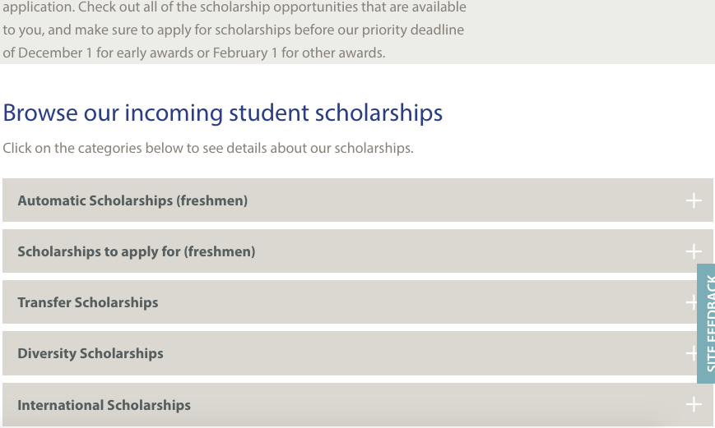

Slide 21
FAFSA
Free Application for Federal Student Aid
Available October 1st
Apply for FSA ID early
To receive loans, grants, and scholarships (most schools will require students to complete before receiving any scholarships.
FAFSA Completion events
Central: October 10th 5pm & 15th, 6pm
Logan: October 3rd 1:30pm & 15th, 6pm
Notes:
Hayley
Oct 1st application available
Apply using tax information from the prior-prior year. This year is 2017. Get things in order at home to file right away
Much simpler than before: Though requires a list of information: current bank statements, social security numbers, birthdates, marriage dates, etc.

Slide 22
Future Center Services
1-on-1 Advising
College applications
Essay
Scholarship search/application
FAFSA
Job Shadows
Career Connections
Campus visits
Workshops
Notes:
Hayley
Additional resource on top of the counselor, this is our #1 priority

Slide 23
Advisor contact information
Matt Gordy, Logan High School, Aquinas High School
mgordy@lacrossepromise.org, 608-789-7034
Hayley Moe, Central High School, Luther High School
hmoe@lacrossepromise.org, 608-789-2054

Slide 24
Stay Connected!
www.lacrossepromise.org
info@lacrossepromise.org

